Slide 1

INTERNAL HACKATHON-2024
DT-30/08/2024
Venue-Acharya Harihar Seminar Hall

Slide 2

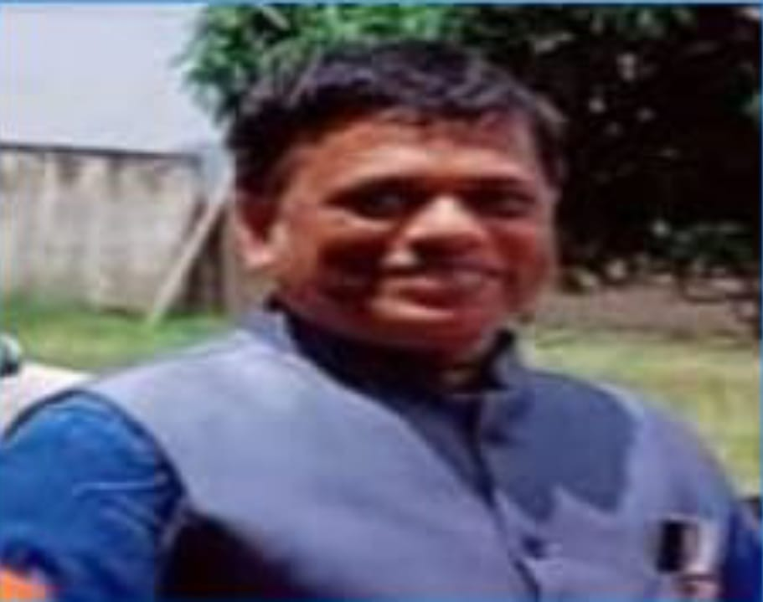
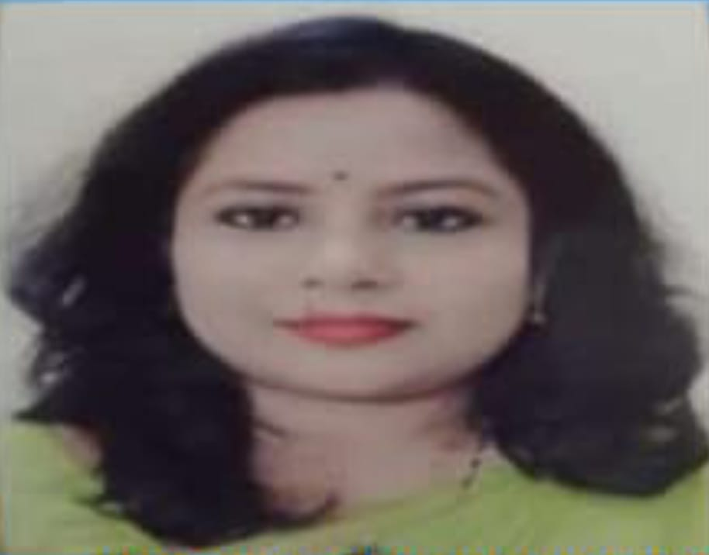
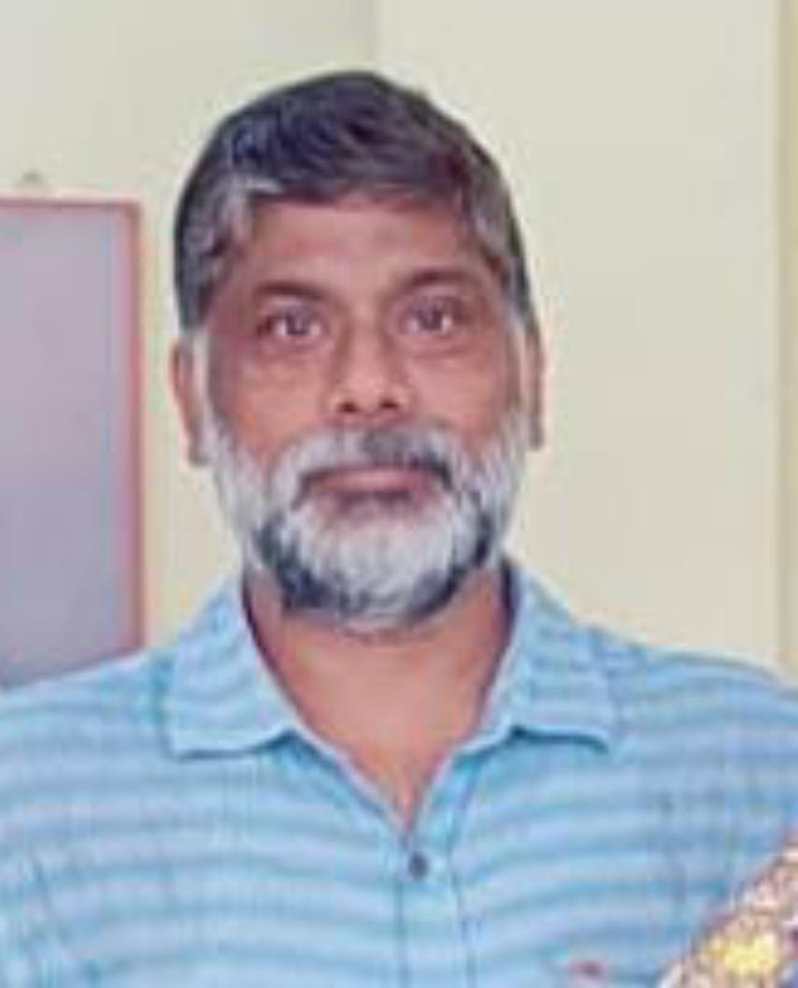
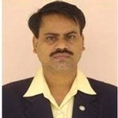
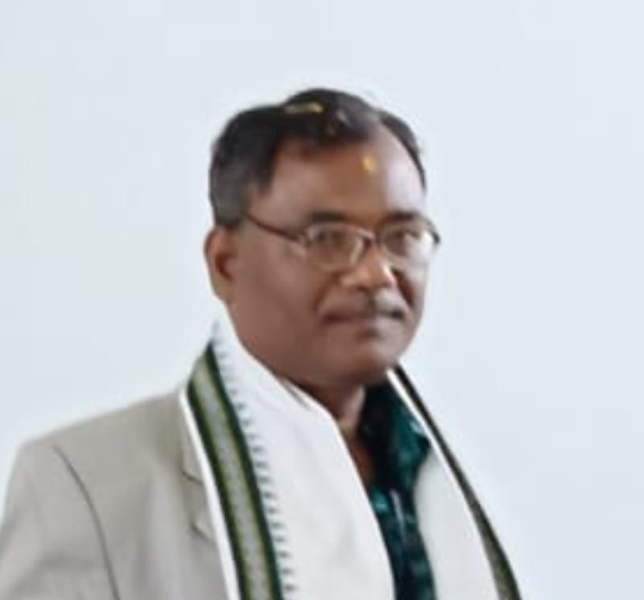
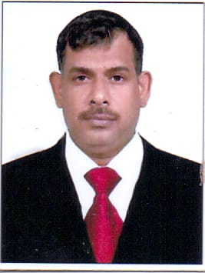
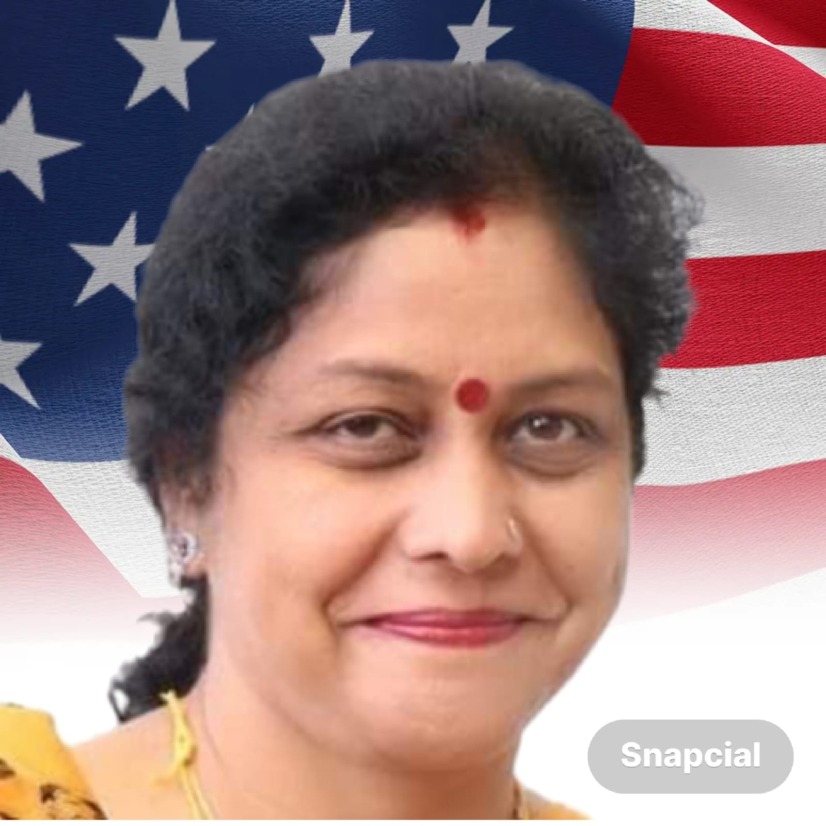
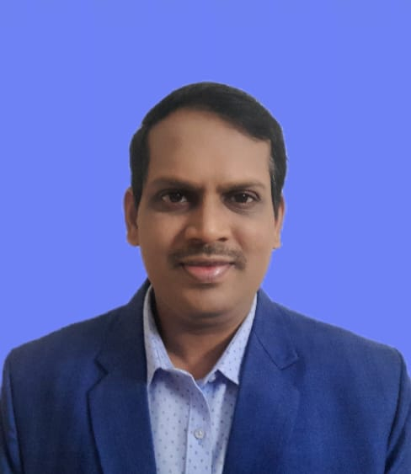
Er. Ashish Kumar Patra
Hon’ble Chairman , PECT and SVGI Bhubaneswar
Prof. Mrs. Sharmistha Jena
Hon’ble Vice Chairman PECT and SVGI Bhubaneswar
Prof. Subrat Choudhury
Director, SVIM & SVCSM,
Bhubaneswar
Prof. (Dr.) Ramesh Ch. Ratha , Principal, SVIM & SVCSM Bhubaneswar
Prof.(Dr.). Dhiren kumar Behera
H.O.D Me & Production Engineering, IGIT Sarang
Dr. Subhranshu Sekhar Dash
H.O.D & Prof .Electrical Engineering Department ,
Govt Engineering college Keonghar
Prof. Rashmi Bharadwaj ,
(FIMA , UK, FISMMACS , INDIA
Pro. (Dr.) Pramod v. Pattar
Nalanda Internal Research
University India

